Slide 1
Presbyterian Mission Agency Invites You
“Actively Engaged in the World”
Notes:
Share Invitation – NOT Initiative
Originated with overture to GA 222 (2016); affirmed GA 223 (2018)
Being shared with all congregations, mid-councils and organizations in PC(USA)
The PMA”s focus on Matthew 25 came as a result of the Mission Agency developing our “why statement.”
Our leadership cabinet used Simon Sinek’s book, Developing Your Why to create this “why statement.”

Slide 2

Matthew 25 – Origin
Notes:
The Matthew 25 vision originated in a General Assembly overture in 2016 (Portland) and was underscored again by the General Assembly of 2018 (St. Louis). The overture was introduced by Cascades Presbytery.
It is not a “new” initiative coming out of “Louisville.” Rather, it’s a validation of the ministries that our churches and mid-councils are already doing and it’s an identification – a re-branding of the PC(USA). It’s Vision for us as a denomination to return to our missional roots!
Matthew 25 provides a sound biblical and theological basis for the Presbyterian Mission Agency’s Work Plans.

Slide 3
Presbyterian Mission Agency
“We believe God calls us to act boldly and compassionately so that faith comes alive and the world wakes up to new possibilities.”
Notes:
Based on a study of Simon Sinek’s book Discovering Your Why
“Why” goes deeper to understanding what motivates and inspires us.
As John’s Gospel tells us, “New possibilities—new ways of living together so that all people have the opportunity to live to the fullest.” John 10:10

Slide 4
Matthew 25 – Origin and Practice
  Building Congregational Vitality
  Dismantling Structural Racism
  Eradicating Systemic Poverty
Notes:
Matthew 25 provides a sound biblical and theological basis for the Presbyterian Mission Agency’s 2019-2020 focus …
Congregational Vitality – Vitality is not determined by the size of the congregation or budget, but to the faithfulness in sharing the Gospel in word AND deed in our communities - by challenging congregations and their members to deepen and energize their faith and grow as joyful leaders and disciples actively engaged with their community
Structural Racism – Awareness; Acknowledgement – Dismantling structural racism has to do with fearlessly applying our faith to advocate and break down the systems, practices and thinking that underlie discrimination, bias, prejudice and oppression of people of color.
Systemic Poverty – Why are people hungry? Change policies.
The Presbyterian Mission Agency has resources to share with you in each of these area and also wants to learn about resources you may have that others can use.
In order to become a Matthew 25 church, mid-council, group or agency, you need only to commit to one or more of the three Mission Agency foci and be willing to submit stories sharing how the impact of being a Matthew 25 church impacts your community and organization.

Slide 5
Connectionalism
  1037 Congregations
  80 Presbyteries
  10 Synods
  57 Other Groups
Notes:
Other:
5 College/University/Seminary
6 College groups
YAV + 7 sites; including 2 international
2 National Caucuses + 5 regional
3 Camps/Conferences
2 New Worshiping Communities
1 International Congregation
3 PCUSA Agencies + PW + 2 local
17 Ministry/Network/Study Group/Fellowship/Task Force
Synod:
18 Congregations (3 LosRanchos; 6 Pacific; 3 Riverside; 4 San Diego; 1 San Gabriel; 1 Santa Barbara)
3 Presbyteries (Riverside; San Gabriel; Pacific)
Other Groups include: CPM Task Force (Burbank) – Raising Leaders of Color
1st Pres Newhall Matthew 25 Study Group

Slide 6
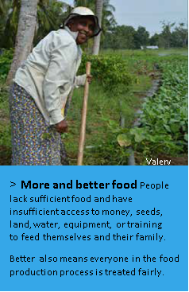
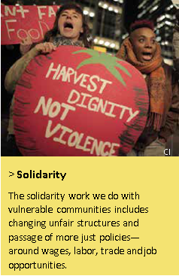
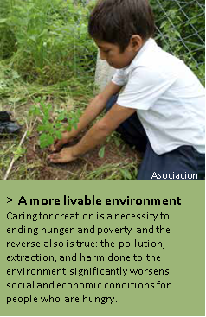
Presbyterian Hunger Program
More and Better Food
Solidarity
A More Livable Environment
Notes:
Food – access to land, seeds, funding, water, equipment, training – 21 countries
everyone in the food production process treated fairly
Solidarity – Advocacy for land rights, fair trade policies, migrant worker rights,
affordable housing
Environment – trees, water systems, sanitation

Slide 7






Office of Public Witness
Presbyterian Church (U.S.A.)
Advocacy as Discipleship:
A People Called
to Witness
by Blair Moorhead
Office of Public Witness
Notes:
Presence in DC since 1946
Social witness policy of GA
Communicate with policy-makers & staffs – visits, calls
Testify before Congress
Facilitate testimony of church leaders

Slide 8
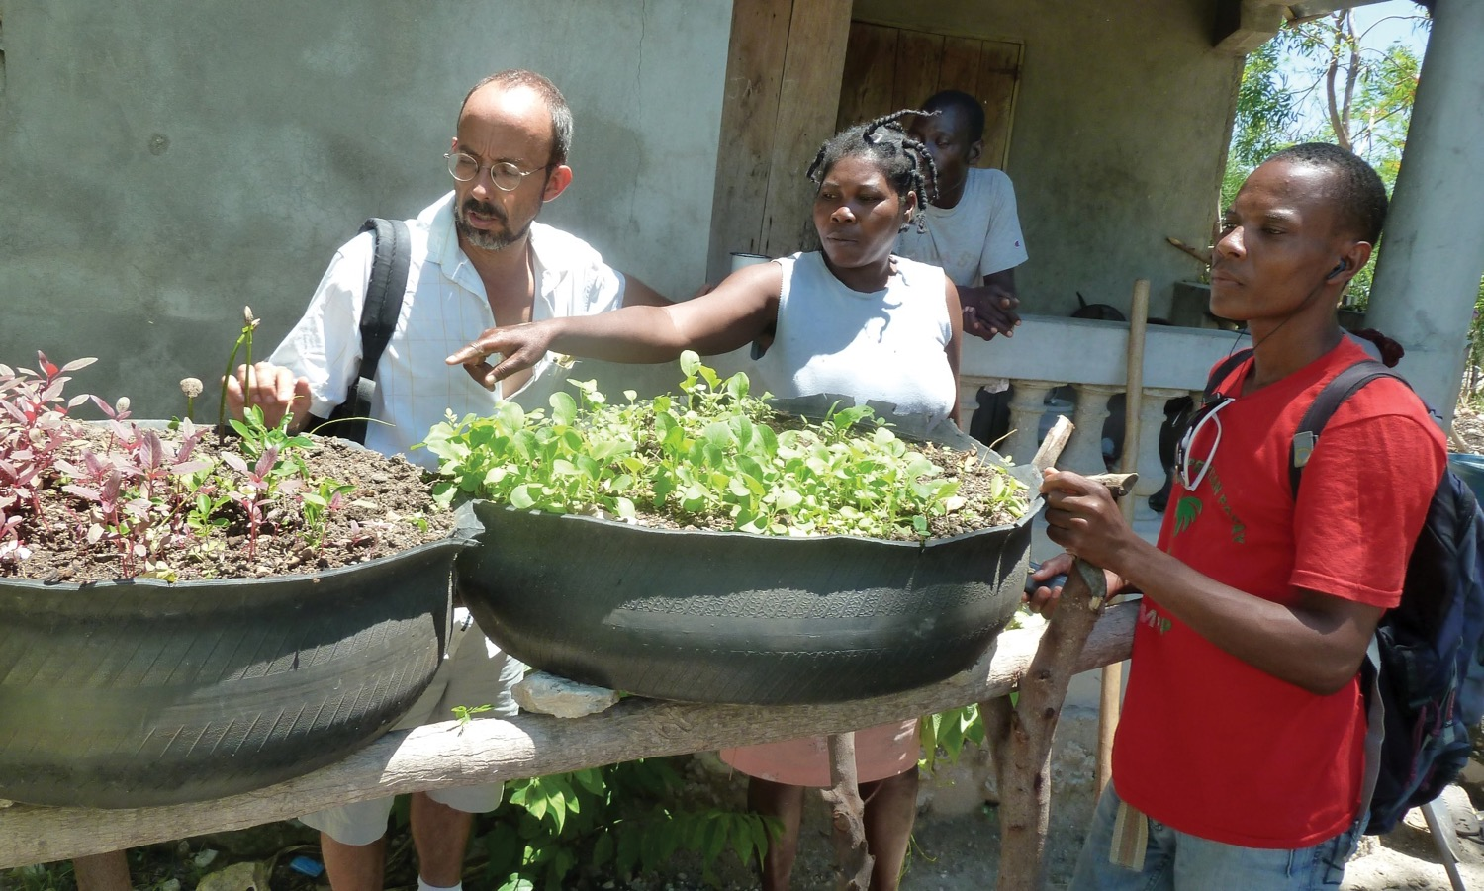
Presbyterian World Mission
78
Mission
Co-Workers serving in 80 countries
Notes:
Sustainable agriculture
Anti-violence – migration mitigation
Human trafficking
Education

Slide 9
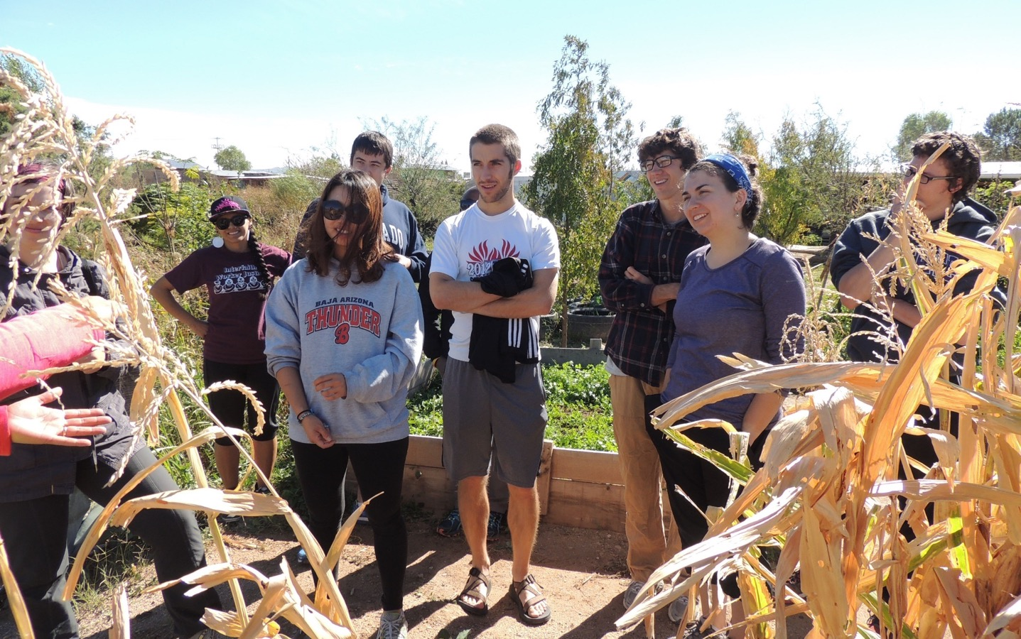
Young Adult Volunteers
40
Young Adult Volunteers serving in
9
sites across 4
countries
2
virtual
Notes:
YAVs accompany local agencies working to address root causes of poverty and reconciliation. Alongside this work, volunteers explore the meaning of their Christian faith and accountability to their neighbors in community with peers and mentors.

Slide 10
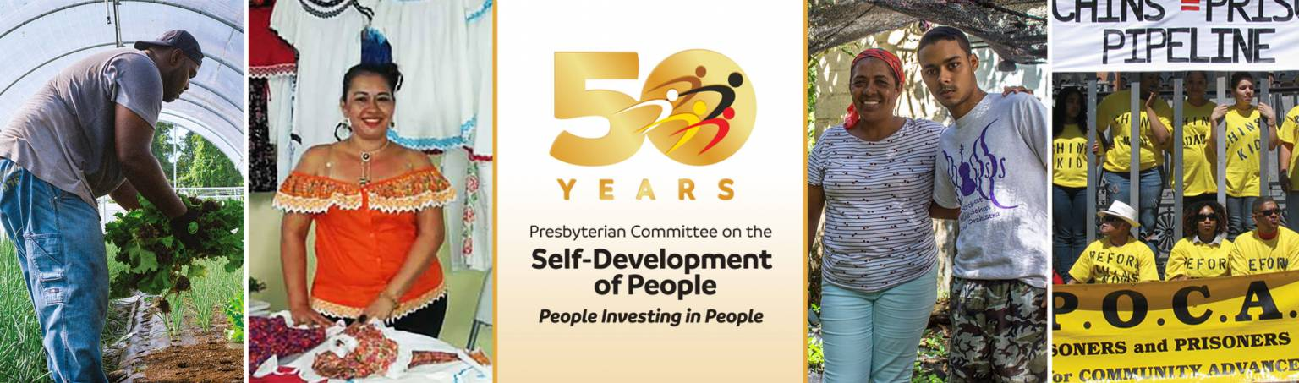
Self-Development of People 50th Anniversary
National Grants
$252,900
19 Programs
Mid-Councils
$104,172
19 Presbyteries & 1 Synod
International
$39,656
8 Countries
Notes:
Presbyterians and ecumenical partners dissatisfied with poverty and oppression, united in faith and action through sharing, confronting, and enabling by participating in the empowerment of economically poor, oppressed, and disadvantaged people, seeking to change the structures that perpetuate poverty, oppression and injustice.

Slide 11
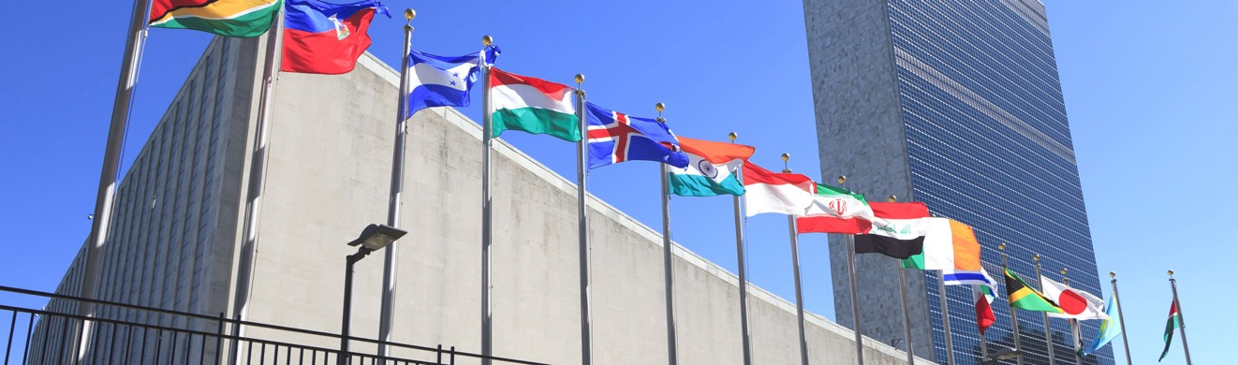



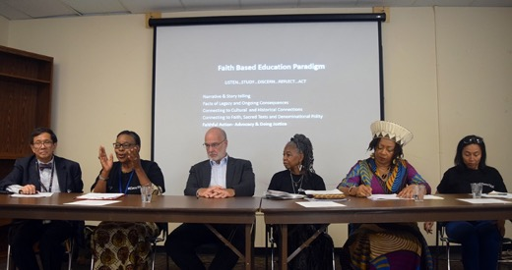
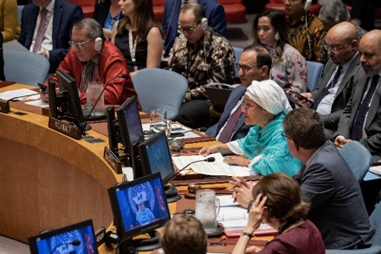
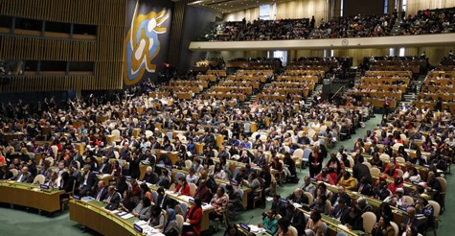
Presbyterian Mission at the United Nations
UNITED NATIONS SECURITY COUNCIL
Notes:
Hold special consultative status through the UN Economic and Social Council
Represents the PC(USA) on the Security Council Working Group – advisory voice to Council

Slide 12
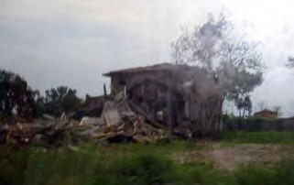
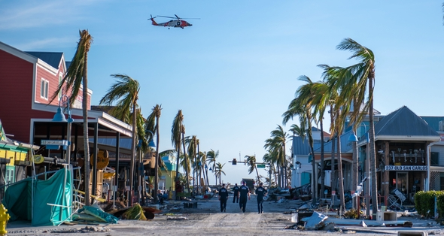
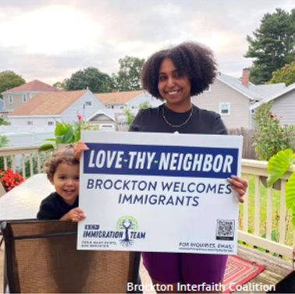
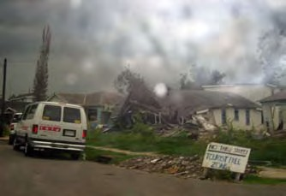
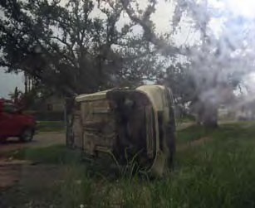
Presbyterian Disaster Assistance
Hurricane Relief
Immigrant & Refugee Ministries
Hurricane Katrina
– New Orleans…
Notes:
Partner with Presbyteries – immediate relief work – partner with other agencies
Long-term development work

Slide 13
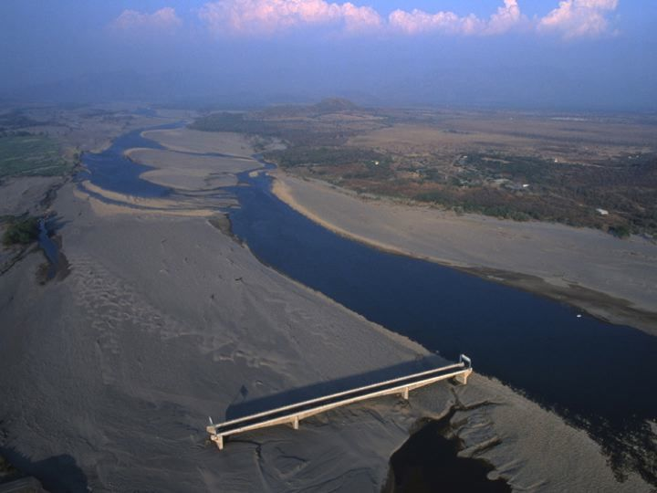
Bridge in Cholocanas, Honduras
Notes:
One of only 7 bridges in Honduras to withstand Hurricane Mitch.
Hurricane changed the course of the river; the bridge no longer spans it.
Like this bridge, our church structures may be strong, but may be irrelevant in our current context.

Slide 14
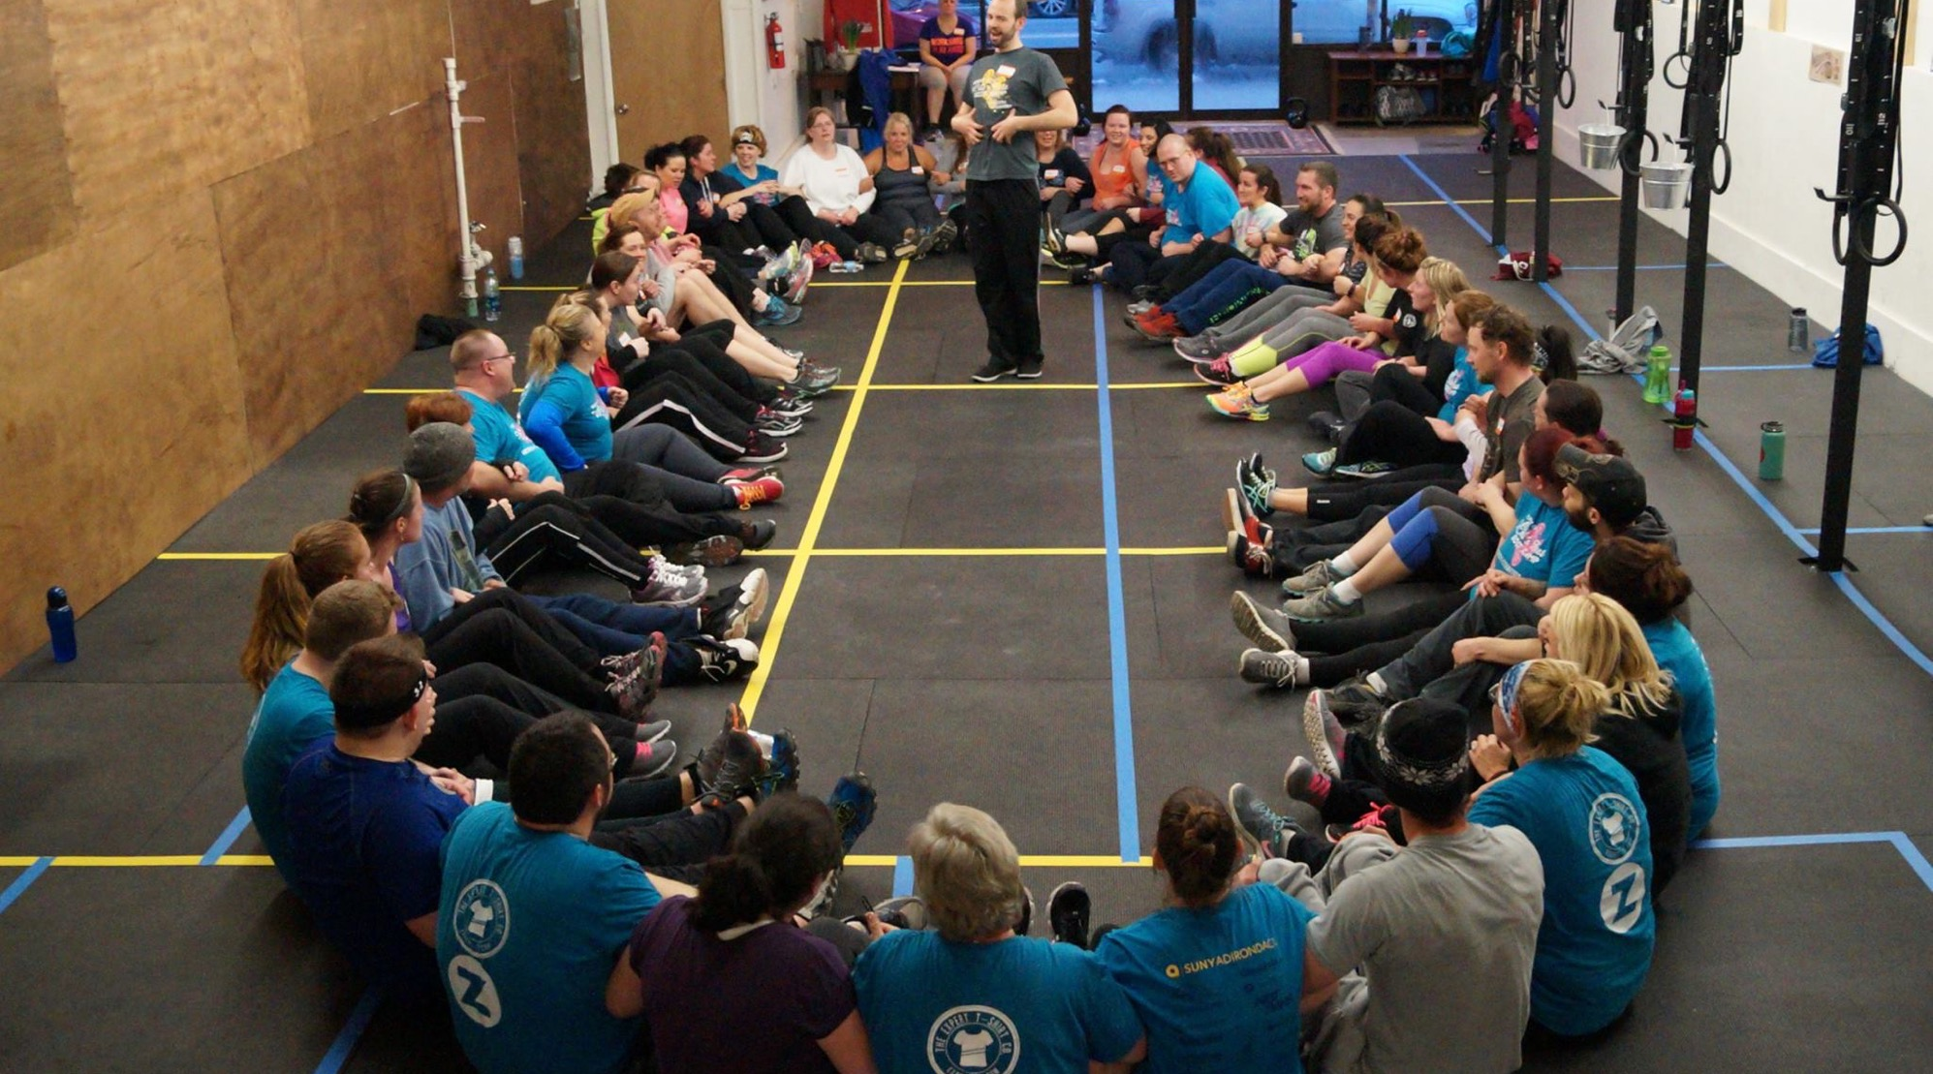
1001 New Worshiping Communities

Slide 15

7 Marks of Congregational Vitality
Lifelong Discipleship Formation
Intentional Authentic Evangelism
Outward Incarnational Focus
Empower Servant Leadership
Spirit-Inspired Worship
Caring Relationships
Ecclesial Health
Notes:
7 Marks of Congregational Vitality
Lifelong Discipleship Formation VS. Complacent "Christian" piety, simply teaching good morals, or offering the latest programs.
Intentional Authentic Evangelism VS. “Jesusfreeks"; "Christian" Hypocrisy; An Evangelism committee.
Outward Incarnational Focus VS. Inward Institutional Survival; Closed communities of assimilation/exclusion.
Empower Servant Leadership VS. the Pastor's job; monopolized leadership; hiring the young energetic pastor
Spirit-Inspired Worship VS. Self-gratifying worship, stale ritual divorced of meaning, or consumer entertainment worship
Caring Relationships VS. Any other Social Club; facades, hypocrisy, and judgment of "church" and "religion.“
Ecclesial Health VS. Unhealthy dysfunction; toxic environments; obsolete and irrelevant buildings

Slide 16





Special Offerings
Notes:
4 church-wide offerings help share Christ's love with millions of people around the world – close to home and far reaches
Share stories of how you are using your portion of the Pentecost and Peace & Global Witness Offerings

Slide 17

Notes:
Presbyterian Giving Catalog: Way to engage families and children in gifts that make a difference in the name of Christ.

Slide 18

Swahili proverb
“If you want to travel quickly, go alone.
“If you want to travel far, go together.”
Notes:
Let’s go far, together!

