Slide 1
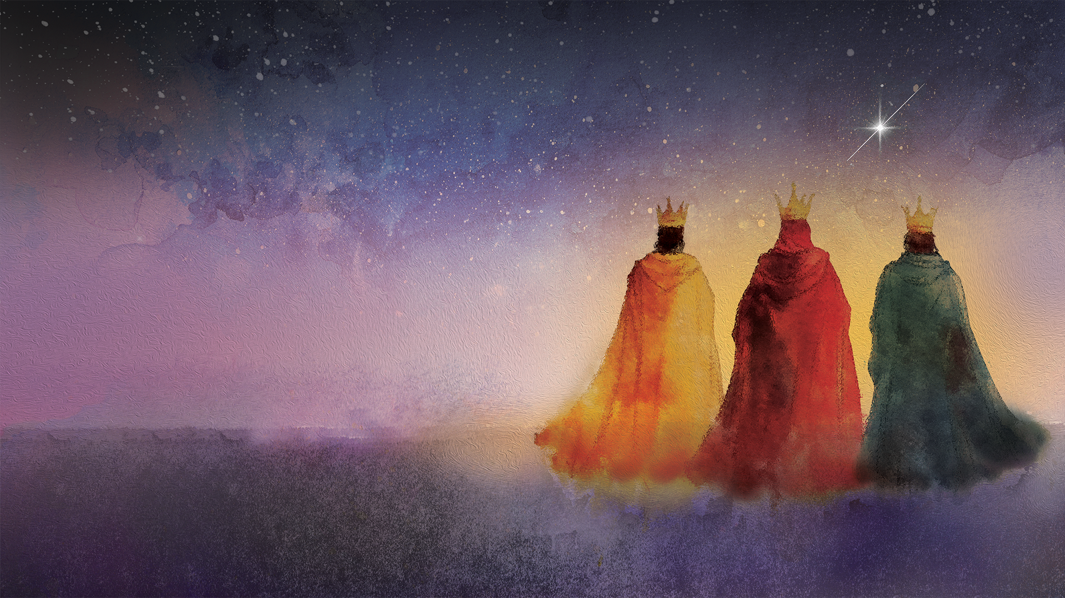



Slide 2


Walking humbly means remembering that we belong to one another; we are all connected through Christ.

Slide 3


Jesus, the light of the world, brings hope.
Together, we can bring hope to others by receiving the Christmas Joy Offering.

Slide 4
WE CELEBRATE
retired pastors, church workers and their families who have faithfully guided and led us.

Slide 5
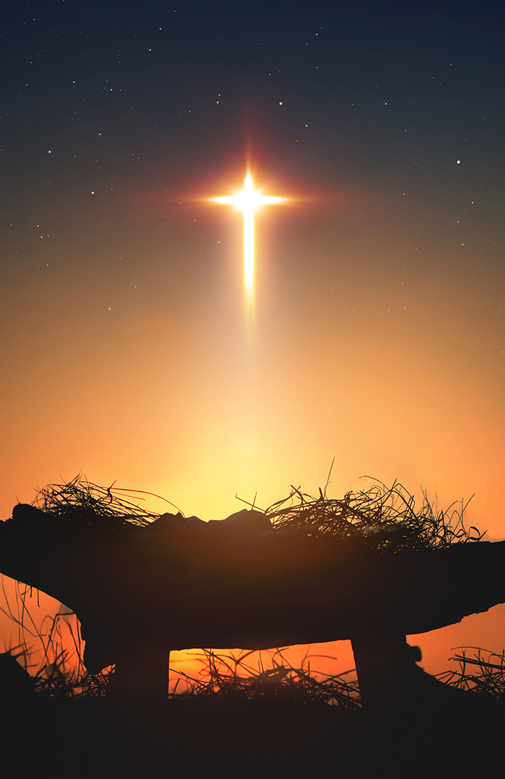
WE CELEBRATE
emerging leaders in schools and colleges equipping communities of color to serve God, the Church and the world for years to come.

Slide 6
WE CELEBRATE
young people, building a foundation of faith to instill in them an understanding of the ways God comes to them every single day.

Slide 7
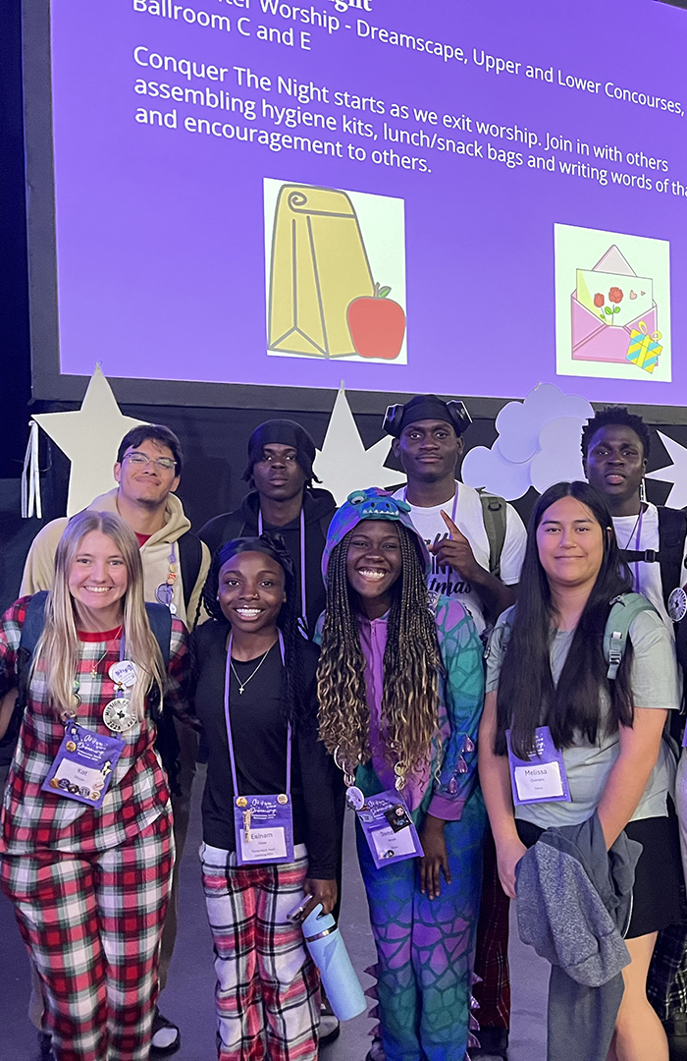
A MINUTE
FOR MISSION
Hope Restoration South Sudan

Slide 8
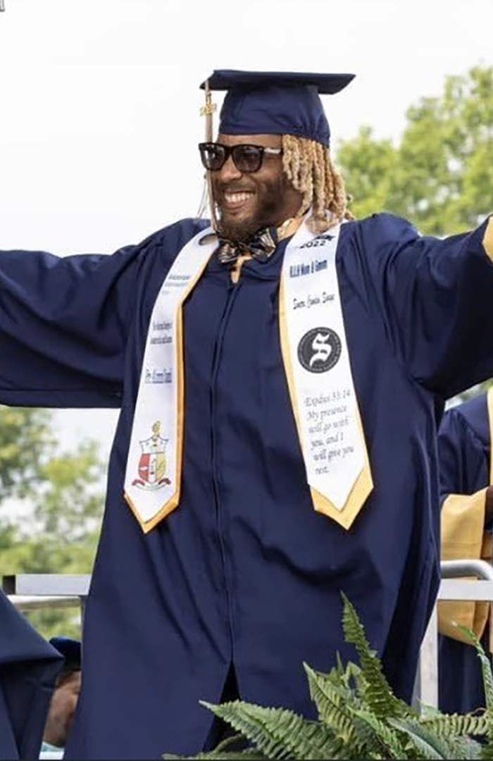
A MINUTE
FOR MISSION
Hope Restoration South Sudan

Slide 9
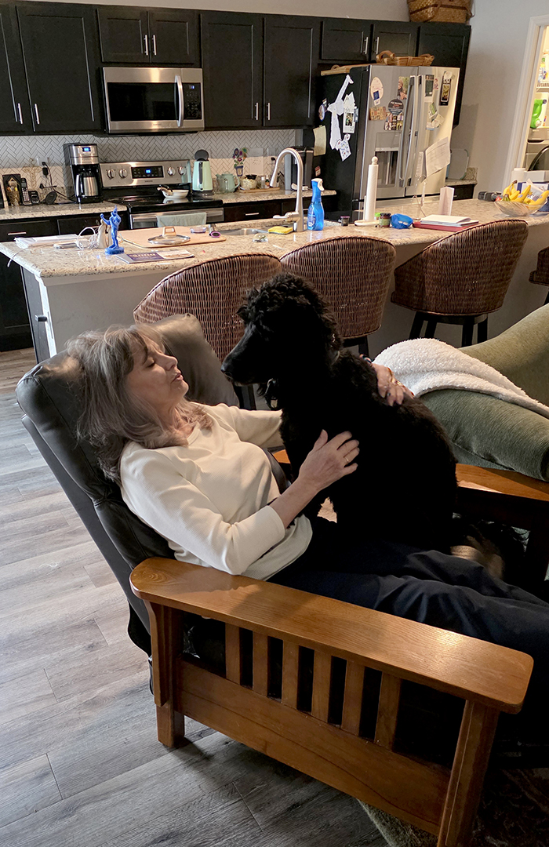
A MINUTE
FOR MISSION

Slide 10
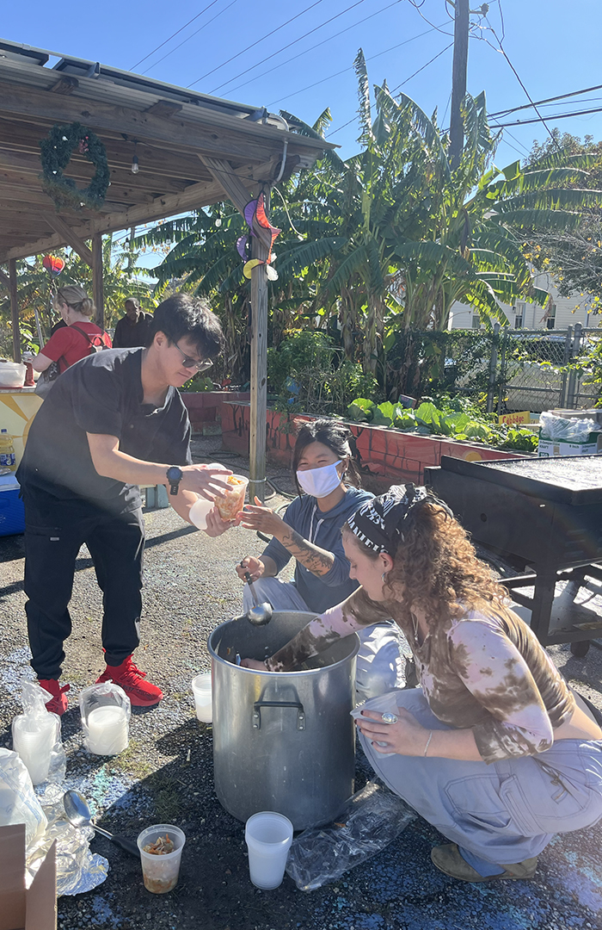
A MINUTE
FOR MISSION
Hope Restoration South Sudan

Slide 11


O God, help us share your love around the world with siblings we meet only at your Table of Grace. May our giving enliven meaningful relationships around the globe so that we see each other more clearly for our world’s sake. Amen

Slide 12

JOIN US!
Thank you for giving what you can.
IF WE ALL DO A LITTLE, IT ADDS UP TO A LOT!
pcusa.org/give/christmasjoy

Slide 13
We are the Church,
Together.

